Slide 1
Pitch’n
Avik Gomes, Tanya Jain, Crystal Song

Slide 2
Status Quo
People don’t know what to donate
Donations are often not appropriate for the charity
Disposing of unusable items can actually cost the charity more money
In the case of clothing donations:
Charities have issues with soiled, torn, or unusable clothes
25% of clothing donations end up in landfills (goodonyou.eco)
Notes:
Creating Empathy
Slide 1: Establish the inadequacy of current clichés (Status Quo)

Slide 3
Schenkelburg, president of Miriam’s Kitchen From the Washington Post
“We didn’t get much that was ridiculous,” ... “The problem was getting reasonable items that weren’t appropriate for our population. The vast majority of our clients are men living outside. We have little need for suits or women’s or children’s items. Someone would clean out a closet, and we’d be inundated. We’d spend a lot of staff or volunteer time sorting through bags of donations. It stressed out staff to have to triage the stuff, and it taxed our physical space. We’d give usable items to the Salvation Army, but that’s again costing us time and resources and probably wasn’t the donor’s intent.”
Notes:
Creating Empathy
Slide 1: Establish the inadequacy of current clichés (Status Quo)

Slide 4
Observations
No reliable way of knowing what donation centers accept and don’t accept
Different donation centers want different things
One has to visit each charity’s website to view their donation guidelines
Locating centers is a hassle
Information on google maps is usually inaccurate and not updated.
Notes:
the hours aren’t updated, no covid related guidelines available

Slide 5
Frustrations
Donator:
You’ve decided to donate some items in your pantry that you don’t want. You decide to drive to a soup kitchen, the only one you know, missing one that may be closer. You give them the donation only to find out later on that they have no need of what you’ve given them.
Donation Center:
You are receiving a deluge of donations for the holiday season but you don’t have enough volunteers to sort through all the items. Because of this, many perishables go bad in the meantime. While the items are being sorted, you lose more manpower because you need some of the volunteers to dispose of unusable items.
Notes:
Slide 3: Explain how that's frustrating the target customer (Story)
Creating Empathy

Slide 6
Why people do not donate
“Although there is much to be grateful for when it comes to people giving to good causes, such as that altruism, and that our brain's reward center lights up when we give, what we expect as fundraisers is not always what we get. Neuroscience, in fact, has found that there is a dark side to our altruism. Sometimes we don't give to compelling causes, or we don't provide as much as we could. The problem seems to be most severe when we are asked to give to many people who are far away, even in the direst of circumstances. Or when a particular disaster is not massive enough or dramatic enough.”
“While it is true that there are far too many organizations who pay executives before the people who need help, it is typically quite easy to find out which charities are legitimate. Try looking up “[the charity’s name] scam” on Google and you will quickly find all the information you need. Furthermore, if the cause itself sounds suspicious, try reading more information from third-party sources, such as news sites or scholars who study these problems. If there is no other information out there, you may want to consider donating to a different cause.”
Ten Reasons Why People Don’t Donate to Charity, from The Life You Can Save
Reasons People Don't Donate to Charity, From Sylvester Knox
Notes:
Building Tension
Slide 4: Tell them something they don't know (Insight - Requirements)
https://www.thelifeyoucansave.org/common-objections-to-giving/
https://www.thebalancesmb.com/why-donors-dont-give-2502028
https://sylvesterknox.medium.com/reasons-people-dont-donate-to-charity-4ec8a3cbe2e9

Slide 7
What Pitch’n does
Pitch’n shows the locations of the nearest centers, so that the donator can see the distance they need to travel to make a difference
Real legitimate organizations are shown, so Donators will know that the items they donate will go to people who actually need them.
Notes:
Building Tension
Slide 5 - 7: Provide a sense of how this knowledge could be used (Opportunity - Analysis)

Slide 8
What Pitch’n does
The Pitch’n system also shows what items a Donation center needs so not only do the Donators know what to donate and where but the centers get items they actually need.
The Pitch’n system also lets you save center and its so you can see when you can help the center.
Notes:
Building Tension
Slide 5 - 7: Provide a sense of how this knowledge could be used (Opportunity - Analysis)

Slide 9
What Pitch’n does
Each time someone sees that a Donation center needs something, they can see the effect they created right away, getting a sense of satisfaction right away making them want to donate again.
People do not have to donate on sites that take their money and they never see it again. Instead they can go to the nearest Donation center and also see what kind of difference they are making.
Notes:
Building Tension
Slide 5 - 7: Provide a sense of how this knowledge could be used (Opportunity - Analysis)

Slide 10
Analogy
Pitch’n is kind of like a notice board, where charities can have all their information in one place for everyone to see rather than having individual flyers spread around where people may not see them.
Notes:
Building Tension
Slide 8: Use a familiar example to help them understand the potential (Analogy)

Slide 11
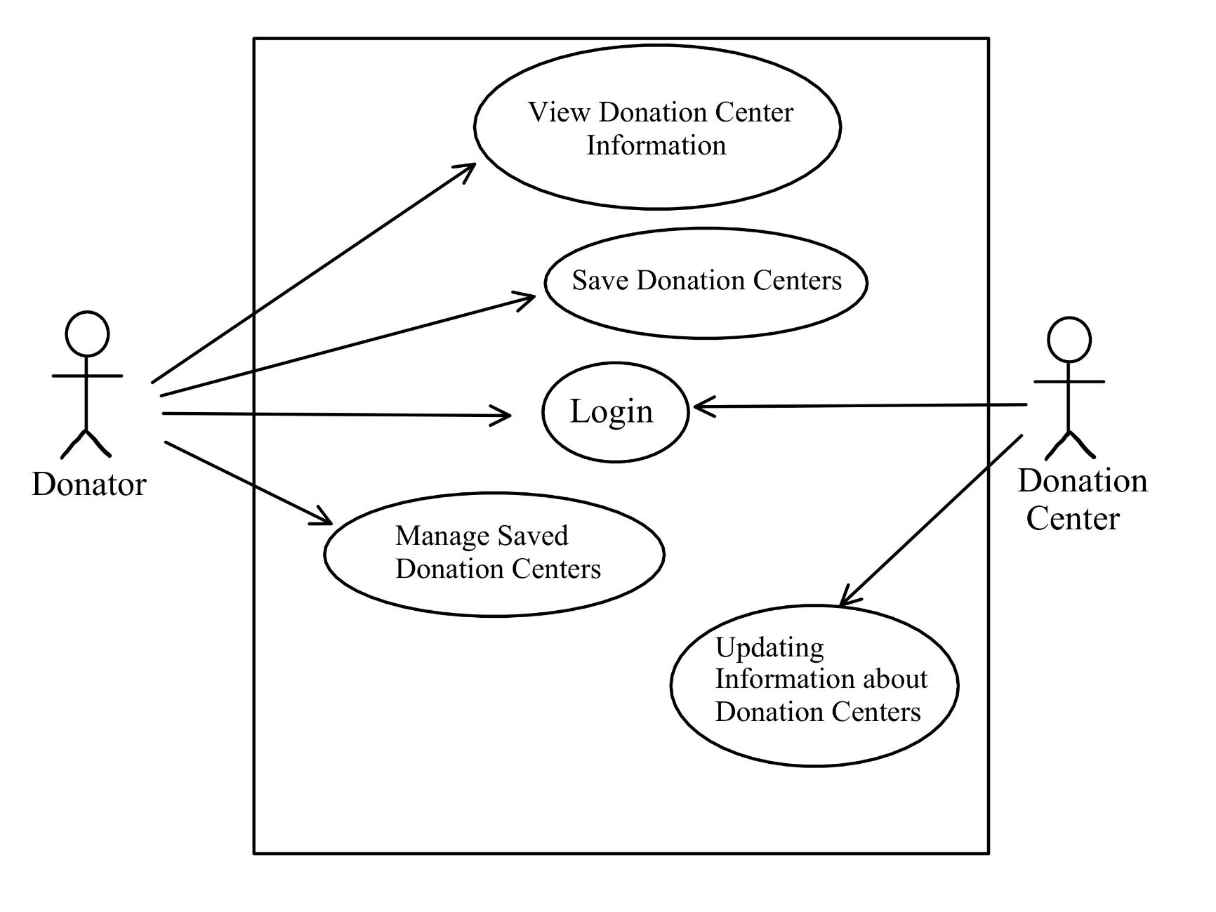
Solution-design
Notes:
Use Case diagram

Slide 12
System requirements
Display donation centers within 10 miles of the user’s location
Enable users to bookmark centers and review centers
Connect to the Google Maps API
Display updated and accurate information
Notes:
Making the Audience Believe
Slide 9 - 11: Reveal the answer to the opportunity (Solution - design)

Slide 13
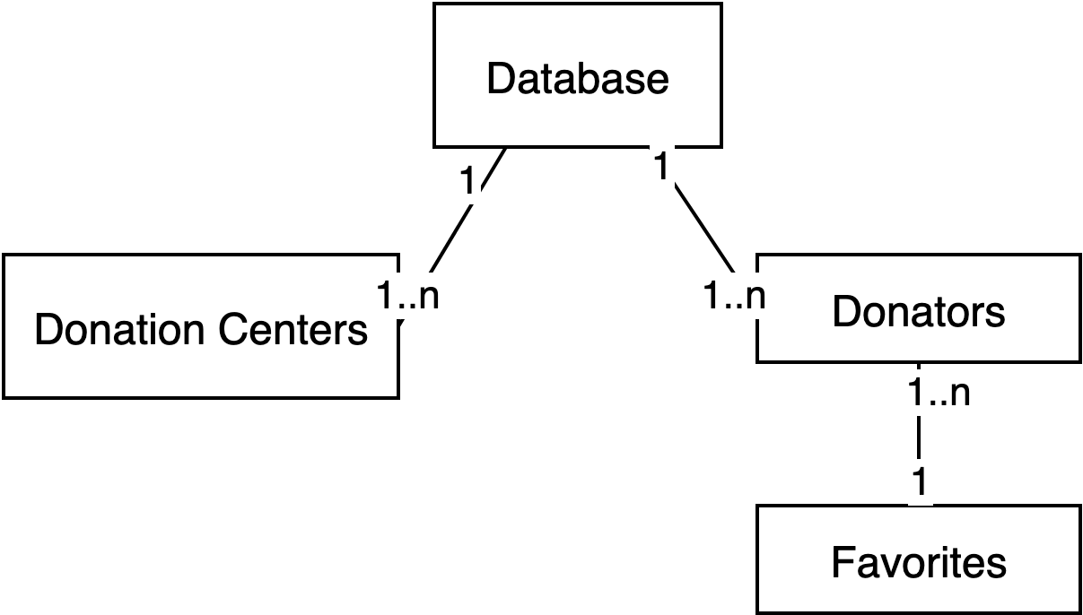
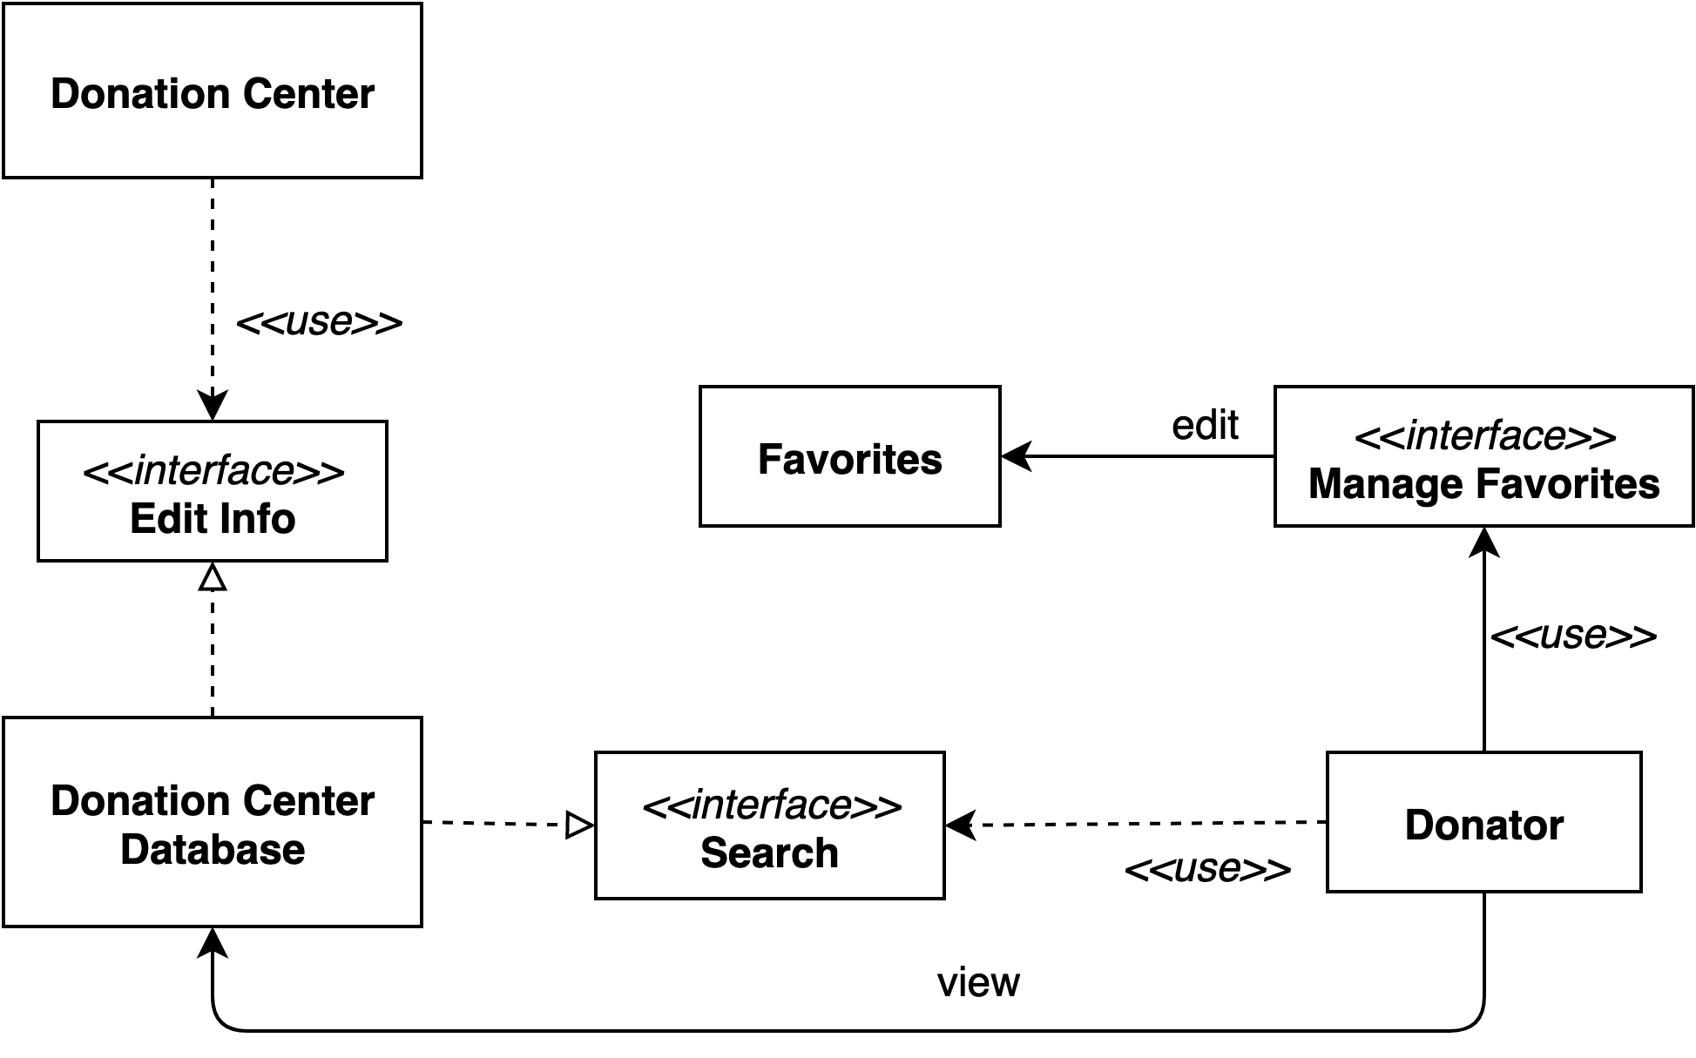
Class diagrams
Notes:
Class diagram(left) class interaction diagram(right)

Slide 14
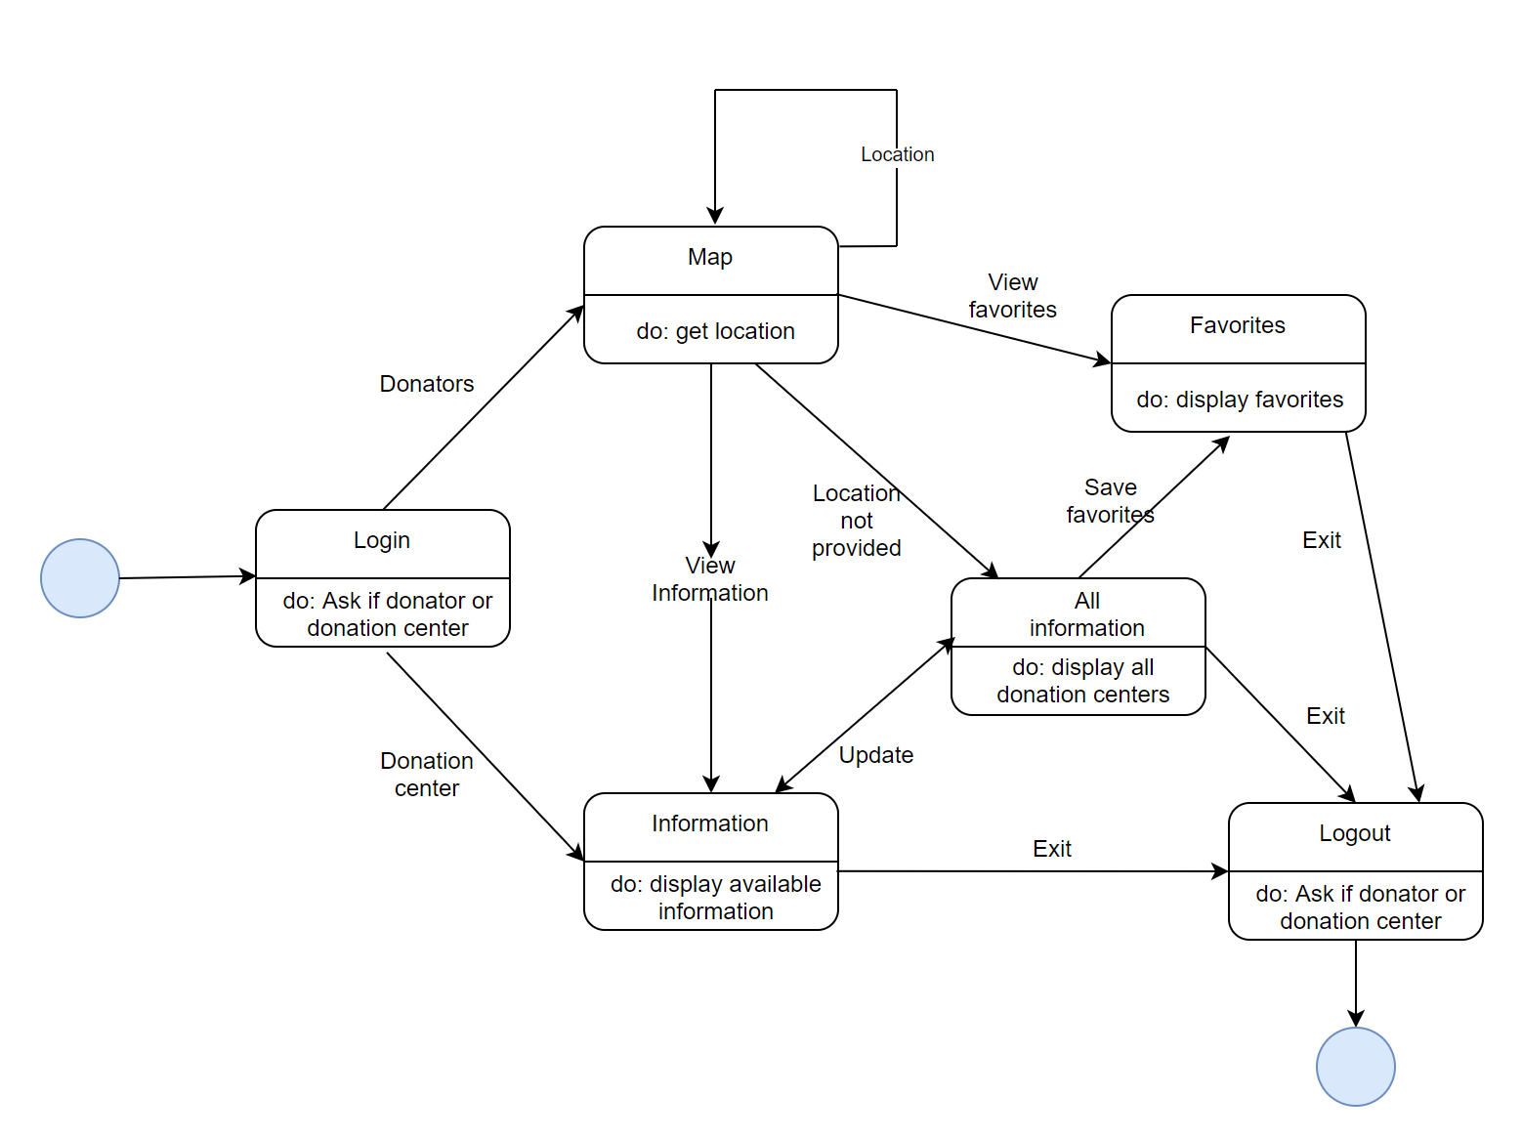
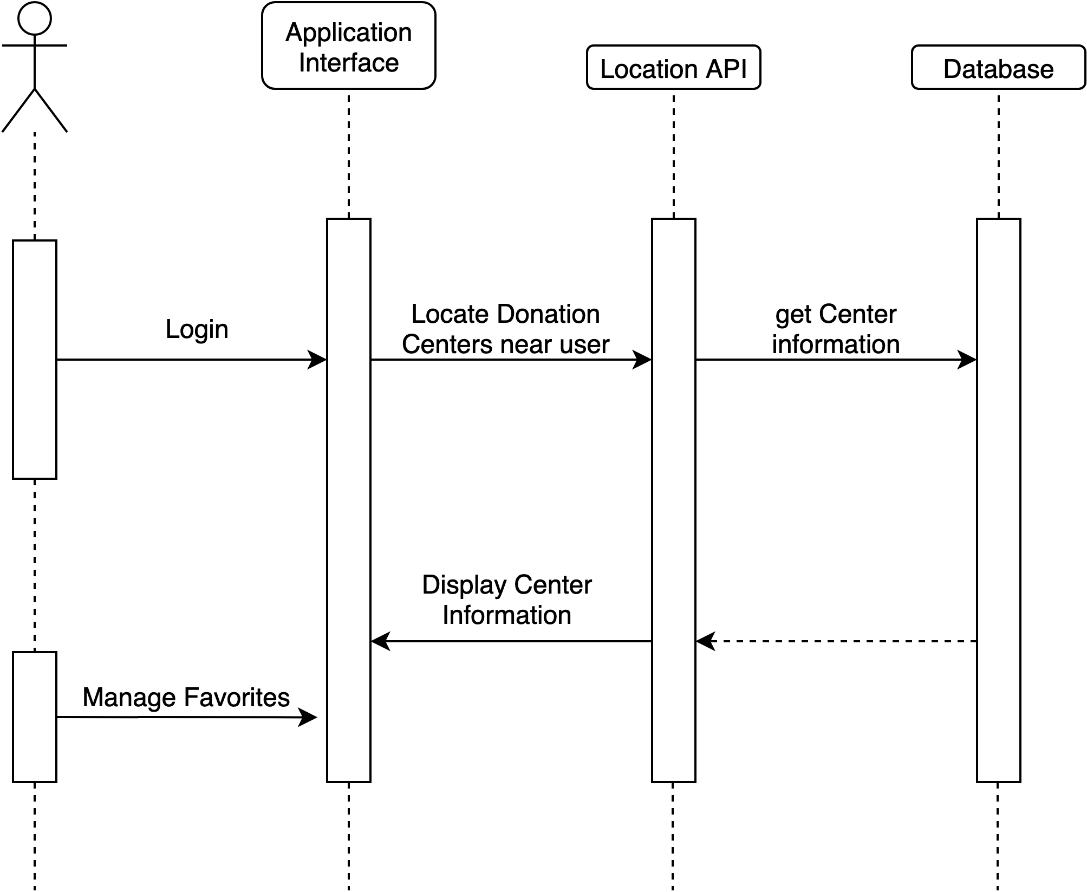
Behavioral models
Notes:
EVent diagram(left) and sequence diagram(right)

Slide 15
Advantages of Pitch’n
Reduce the amount of unusable donations
Spread awareness of what should and shouldn’t be donated
Improve donation rates outside of the holiday season
Make charities more effective in their goals
Notes:
Making the Audience Believe
Slide 12: Explain the motivation for customers and stakeholders to make the changes you're suggesting (Advantage)

Slide 16
Future Work
Complete and implement the project in Spring 2021
Implement a search function for specific items
Establish a connection to charity donation pick-up services
Notes:
Making the Audience Believe
Slide 13: Communicate the solution's higher purpose and potential (Ethos – future work)

Slide 17
Post Implementation Review
Met the project deadlines on time
Created comprehensive documentation
Split the work evenly
Inconsistent formatting of the documentation
Not enough diagrams for support
Difficulties in scheduling work due to time zone differences
Get clarification on documentation details earlier
Seek assistance regarding analysis diagrams
Establish a more concrete work schedule
Notes:
Closing
Slide 14: Post Implementation Review (what we did right, what we did wrong, and what we would change)

Slide 18
Q&A
Any questions?

